Slide 1
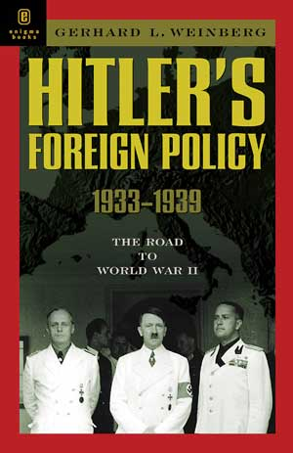
Nazi Germany
Concept of living space
Austria and Czechoslovakia – appeasement in action
Soviet-Germany Non-Aggression pact, 1939
Foreign policy 1933-1939
The outbreak of war
Foreign Policy

Slide 2
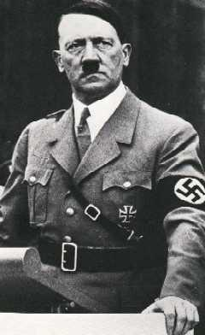
Foreign Policy Aims
Hitler and the Nazi Party believed
in building a strong German
Empire, they actively opposed the
Weimar Republic’s policies and
were embarrassed by the outcome
of World War I.
The Nazis used these ideals to
gain support within the public and
in 1934 Hitler became the Fuhrer.
Hitler’s foreign policy was
therefore based on the points which follow

Slide 3
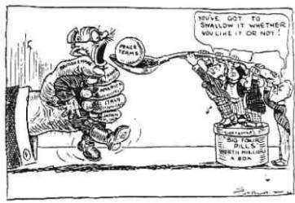
Foreign Policy Aims
Hitler wanted to destroy the Treaty of Versailles: the Treaty was seen as a great embarrassment to Germany, Hitler had built his political reputation on the promise he would overturn it. This would help Hitler rearm Germany and remilitarise the Rhineland.

Slide 4
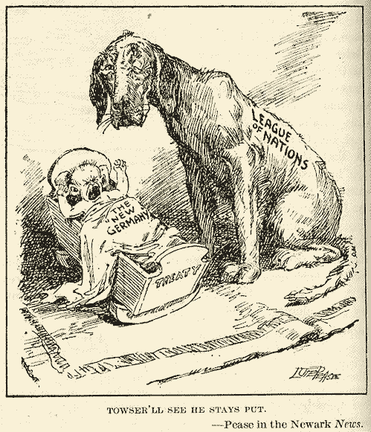
Foreign Policy Aims
2. Removal of Germany from the League of Nations: Hitler aimed to expand the German empire and change the boundaries of nations that the peace treaties and the League had protected for so long.

Slide 5
Foreign Policy Aims
3. Lebensraum: Hitler need ‘living space’ for his ‘master race’, the Aryans. In order to achieve this he needed the territory to expand into.
4. Greater German Reich: Hitler wanted to create a master German race, by uniting all German speaking peoples, in particular Austria.

Slide 6
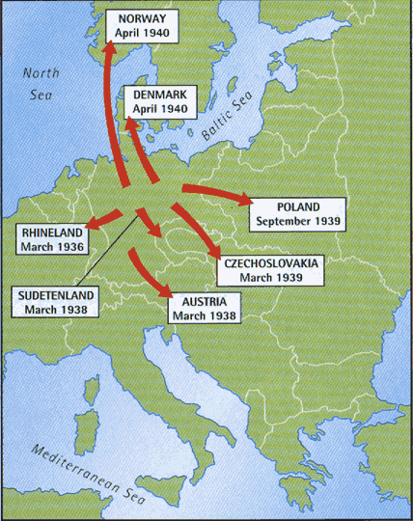
Foreign Policy Aims
5. Attack and Invade the Eastern Europe and Russia: There were several reasons for Hitler wanting to do this;
He wanted to use this land to achieve ‘lebensraum’ and Eastern Europe and Russia were close targets.
He could ‘cleanse’ Europe of Communists and racial inferiors, particularly the Jews.

Slide 7
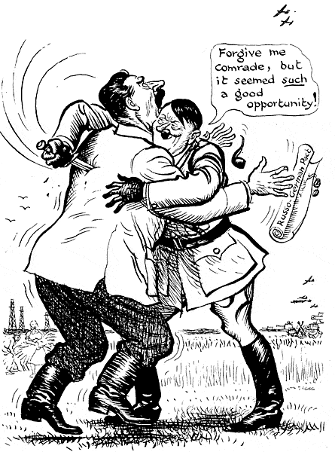
Foreign Policy Aims
(5 continued)
He realised he needed to eliminate any states which may be ‘unfriendly’ towards Germany, in particular Poland and Czechoslovakia.
He also believed that strong empires need certain goods to survive, including food and raw materials both of which could be found in Eastern Europe and Russia. He promoted ‘autarky’

Slide 8
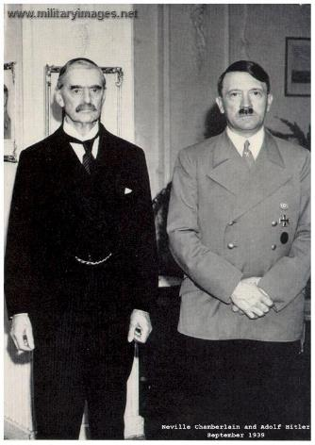
Foreign Policy Constraints
There were some constraints to Hitler’s foreign policy:
Hitler knew that there would be opposition from Britain and France over his aims.
France however was not considered to be a military threat while Hitler believed Britain and Germany were natural allies.
He also used the British and French’s suspicion of Communism to exaggerate the threat of Russia.

Slide 9
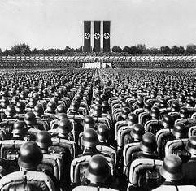
Foreign Policy Constraints
(continued)
He also needed to be cautious as Germany was relatively weak economically and had few allies. Hitler had to represent all his actions as being in the interests of peace, also promising each change would be his last!
Germany had a weak military
i. 100, 000 men in the army
ii. No air force
iii. No tanks
iv. No battleships, U-boats, aircraft carriers

Slide 10
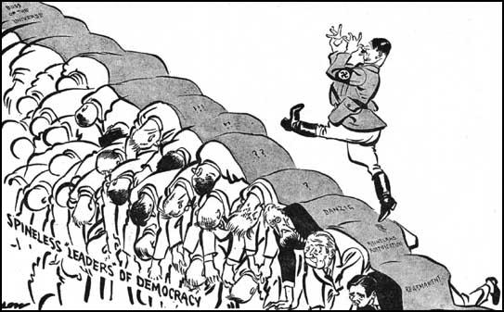
Appeasement
To prevent further disagreement in arguments or war by giving to the opposing side an advantage that they have demanded.

Slide 11
Austria and Czechoslovakia – appeasement in action
Anschluss refers to the annexation of Austria into Nazi Germany on 12 March 1938.
In early 1938, Austrian Nazis conspired for the second time in four years to seize the Austrian government by force and unite their nation with Nazi Germany.
Austrian Chancellor Kurt von Schuschnigg, learning of the conspiracy, met with Nazi leader Adolf Hitler in the hopes of reasserting his country’s independence but was instead bullied into naming several top Austrian Nazis to his cabinet.
On March 9, Schuschnigg called a national vote to resolve the question of Anschluss, or “annexation,” once and for all. Before the plebiscite could take place, however, Schuschnigg gave in to pressure from Hitler and resigned on March 11.
On September 30, 1938, Adolf Hitler, Benito Mussolini, French Premier Edouard Daladier, and British Prime Minister Neville Chamberlain signed the Munich Pact, which sealed the fate of Czechoslovakia, virtually handing it over to Germany in the name of peace.
Although the agreement was to give into Hitler’s hands only the Sudentenland, that part of Czechoslovakia where 3 million ethnic Germans lived, it also handed over to the Nazi war machine 66 percent of Czechoslovakia’s coal, 70 percent of its iron and steel, and 70 percent of its electrical power.
Without those resources, the Czech nation was left vulnerable to complete German domination.

Slide 12
Soviet-Germany Non-Aggression pact, 1939
https://www.britannica.com/event/German-Soviet-Nonaggression-Pact
Non-aggression pact between Germany and the Soviet Union
Paved the way for the joint invasion and occupation of Poland September 1939.
Also called:
Nazi-Soviet Nonaggression Pact
German-Soviet Treaty of Nonaggression
Hitler-Stalin Pact
Molotov-Ribbentrop Pact

Slide 13
The outbreak of war: Causes of WW2
Causes of WW2
Treaty of Versailles
The treaty was very harsh against Germany, ruined the economy, government in chaos
Japanese Expansion
Japan wanted more land and resources – invaded Manchuria (China) 1931
Fascism
Some European countries were taken over by dictators who formed powerful fascist governments. These dictators wanted to expand their empires (Hitler, Mussolini)
Appeasement
To prevent another war, Allied countries tried to make Germany and Hitler happy rather than try to stop him.
Adolf Hitler and the Nazi Party rose to power. He first took over Austria in 1938. When the League of Nations did nothing to stop him, Hitler became bolder and took over Czechoslovakia in 1939.
Hitler and the Nazi Party
Great Depression
Created unstable governments and worldwide turmoil that helped lead to World War II.

